Slide 1


K.RAMAKRISHNAN COLLEGE OF ENGINEERING
(AUTONOMOUS)
Password Generator Application for Enhanced Security
Presented by,
Name : M.HARISH
Register No. : 8115U23EC034
Roll. No. : ECA2334
Year & Dept : II / ECE
Date of Review : __________

Slide 2
PRESENTATION OVERVIEW
Objective
Architecture diagram
Modules
Program
Output
Conclusion

Slide 3
OBJECTIVE OF THE PROJECT
.
Create random passwords that are resistant to common attacks. Allow users to specify criteria for password generation, including length and character types. Ensure generated passwords adhere to security best practices. Provide an easy-to-use interface for setting preferences and viewing generated passwords.

Slide 4
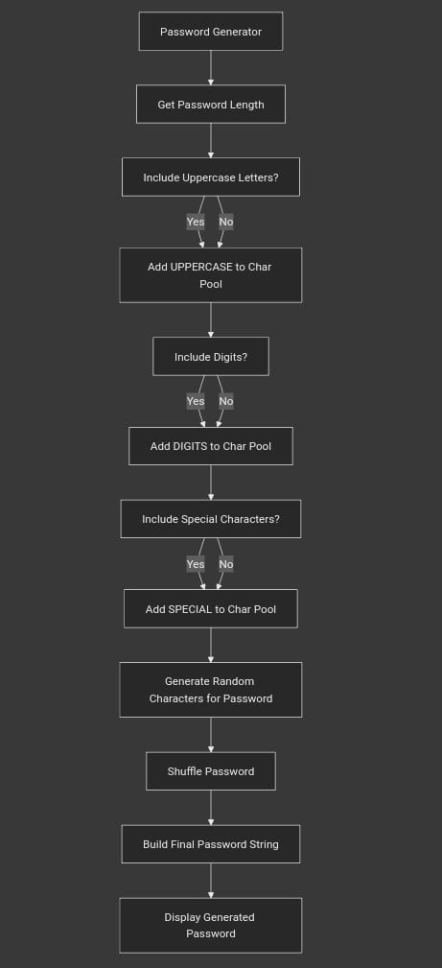
ARCHITECTURE DIAGRAM
.

Slide 5
MODULES
User Interface Module:
Input fields for specifying password length and character type preferences.
Button to trigger password generation.
Display area for showing the generated password.
Password Generator Engine:
Randomization Logic: Randomly selects characters from specified sets.
Password Construction: Assembles characters into the final password.

Slide 6
MODULES
3.Validation Module:
Complexity Check: Verifies that the password meets user-defined criteria.
Strength Assessment: Optionally rates the password strength.
4.Configuration Manager:
User Preferences Storage: Saves and retrieves user settings.
Settings Management: Allows users to adjust default preferences.

Slide 7
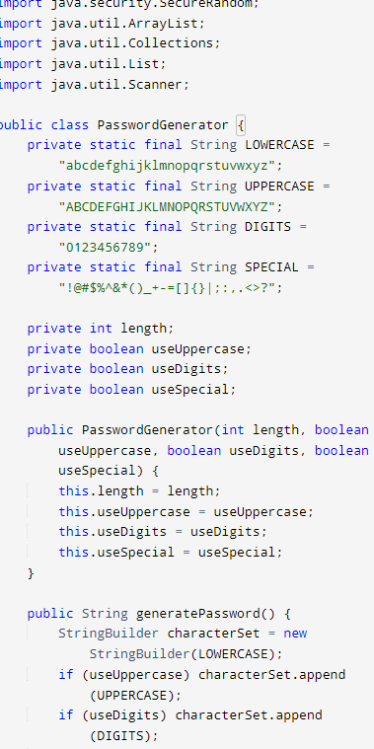
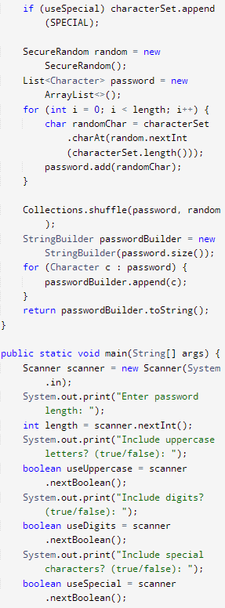
PROGRAM SCREENSHOT
SCREENSHOT 1
SCREENSHOT 2

Slide 8
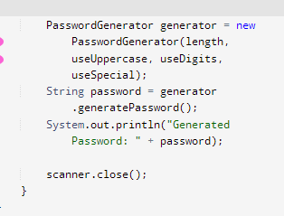
PROGRAM SCREENSHOT

Slide 9
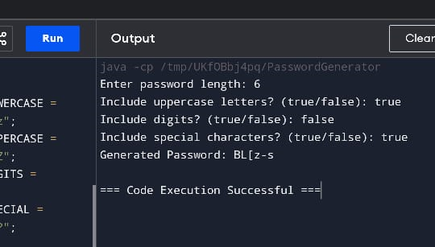
OUTPUT SCREENSHOT

Slide 10
CONCLUSION
The Password Generator Application effectively allows users to create secure, random passwords tailored to their specific needs. By providing customization options and adhering to security best practices, the application enhances online security and helps users protect their accounts from unauthorized access. Regular updates to the application's security features will ensure its continued effectiveness in an evolving threat landscape.

Slide 11


